Slide 1

Project Report
Title: Email Slice
Submitted By: Aakash kumar badal B.tech(CSE)
Reg.No. 12203599 Submitted To: Mr. AvnisH Thakur
Section: KOC01

Slide 2
Introduction:
We are going to create a email slicer in which we can add multiple email address as an input and slice it to produce the username and the domain name associate with it.
The email is divided into two strings.

Slide 3
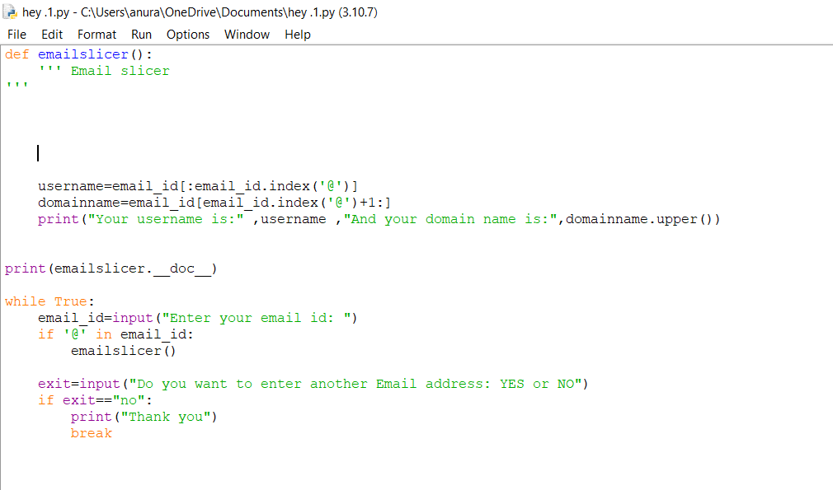

Slide 4
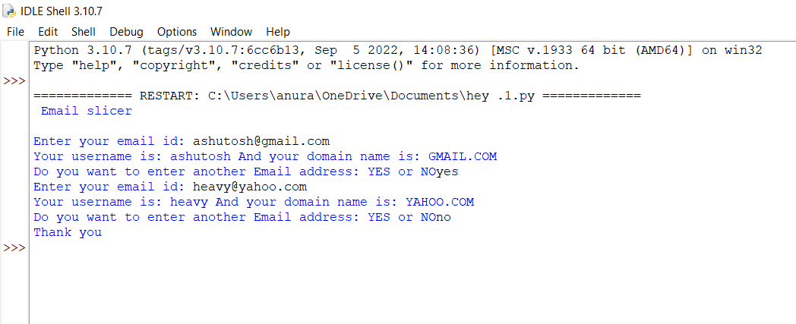

Slide 5
Descrirtion:
Hell0,Welcome to email slicer Python project. This email slicer is developed by Aakash Kumar Badal, Piyush Pandey, Ashutosh Maurya. In this slicer we have used many method and function . When you run the program it will ask you for a email address . You can write your email then it will slice your email into domain and username

Slide 6



